Slide 1
Indo-German Energy (IGEN) Access II Program
Discussion on Possible Areas of Engagement
Department of Energy
Government of Jharkhand

Slide 2
Agenda
1 | Macro-Economic Landscape of Electricity Sector
2 | Key Takeaways of IGEN Access II

Slide 3
Macro-Economic Landscape of Electricity Sector
Policy | Development Goals | Program Objective/ Outcome

Slide 4
Jharkhand: Policy Push for the State
Ranchi Smart City
Inaugurated by Hon’ble Vice President in 2017, the project is at a critical juncture and is a vital cog in overall development of Jharkhand State
Ongoing & Planned Projects
The state is at a critical juncture on socio-economic aspects
Political stability has been attained and Jharkhand is set to traverse a defined growth path on business sentiments & grass-root development of its’ Human Resources
Tribal Welfare
In Union Budget 2020, it has been announced that a world-class tribal museum will come-up in Ranchi at a budgeted cost of 500 – 1000 Cr.
Tribal budget increased to about 54,000 Cr. including 1,200 Cr. special grant to Union Ministry of Tribal Affairs
Rural Employment Scheme
Keeping in mind reverse-migration of laborers due to COVID 19, three schemes have been launched by Hon’ble Chief Minister
Birsa Harit Gram Yojana, Neelambar Pitambar Jal Samriddhi Yojana & Poto Ho Khel Vikas Yojana will be run by Rural Development Department
Mining Reforms
Commercial mining opened-up further with revenue-sharing arrangement, to boost the fuel’s production in India. The same has been part of forth tranche of Rs 20 trillion stimulus package to mitigate economic fallout from COVID 19

Slide 5
Jharkhand: Attaining Sustainable Development Goals (SDG)*
India adopted Sustainable Development Goals at the UN General Assembly which tracks holistic development through 17 Goals and 169 related targets to be achieved by 2030
In India, the program is monitored by Niti Aayog and Planning-cum-finance Dept. is the nodal department in Jharkhand to co-ordinate implementation of SDG targets
Jharkhand was placed 26th (Score: 50) in FY18 and 27th (Score: 53) in FY19 amongst States in composite rank
Ranking under SDG7 (Affordable & Clean Energy) was 27th in both FY18 (Score: 20) and FY19 (Score: 50)
State Indices
Energy Planning
3-year Action Plan formulated at State level, various departments have taken-up awareness generation drives
Nodal departments –
Agriculture, Animal Husbandry & Co-operative Department (Goal 2)
Dept. of School Education & Literacy (Goal 4)
Dept. of Drinking Water & Sanitation (Goal 6)
Dept. of Health, Medical Education & Family Welfare (Goal 3)
SDG monitoring mechanism has been formulated, budgeting and capacity development has also been taken-up for various goals
Dept. of Planning-cum-finance has partnered UNICEF which assists Jharkhand in attaining SDG goals
SDG7 focuses on “ensuring access to affordable, reliable, sustainable and modern energy for all”
Major components envisaged under SDG7 are –
Providing Universal Access to Electricity (Saubhagya)
Focus on Renewable Energy (PM-KUSUM, Solar Rooftop)
Access to Clean Cooking Energy (Ujjwala)
Improving Energy Efficiency (UJALA)
Strengthening International co-operation (IGEN – Access, International Solar Alliance)
IGEN-Access harbors focus on Goal 7 having Energy Dept. as nodal agency
*Data as per Niti Aayog reports on SDG

Slide 6
Program Objective: IGEN Access II
From perspective of Dept. of Energy, access to affordable & reliable energy along-with optimizing fuel sources (Power Purchase) are the two major growth drivers
The State has been able to meet between 4.7% to 13% of RPO targets in past three published FYs, showing highly skewed energy-mix
Measures have been undertaken (tying-up 700MW Solar & 250MW Wind Power along with push to PM-KUSUM, Solar Rooftop programs)
Guidance envisaged in terms of implementation push
Indo-German Energy (IGEN) Access II, as part of ongoing collaboration between respective nations, is a program with underlined objective of improving energy supply in rural areas
The broad values envisaged for Dept. of Energy can be categorized as below -
Access to international expertise which addresses time & resource crunch of the Dept. in making plans for future
No additional financial burden on State exchequer as the program is part of ongoing national level association
Energy scenario planning for next 10-15 years through EAP tool, employee up-skilling, opportunity to align on further state-level visions

Slide 7
Expected Outcome
Clearer understanding of challenges/ barriers in attaining goal of providing clean & reliable energy access
State-level Energy Action Plan for a period of 10-15 years (inline with SDG 2030 timeline)
Decision Support Tool hosted at state-level and operated by core-group of employees to evaluate and analyze scenarios on State’s aspirations from energy perspective
The program, effectively planned, has the ability to push both ranking and score of Jharkhand on SDG Index by impacting other development goals as below -
SDG 1,2 & 3 are designed around elimination of poverty & hunger along-with improving healthcare
Ensuring energy access to last-mile Consumers shall contribute to improving these parameters
SDG 4,5 & 10 address the issues of education, gender equality & reducing social inequalities
Progress in these set of extremely important parameters can be ensured by affordable modes of electricity access
SDG 4,5,10
SDG 1,2,3
SDG 9,11 & 13 focus upon innovation, city planning, industrialization & climate action
In future of innovation or planning smart-cities, a robust Renewable Energy Plan shall play a key role, thus contributing in improving related parameters
SDG 6,8,12
SDG 6,8 & 12 provide importance to access to clean water, sanitation, job creation & sustainable production
Energy access to MSMEs inline with national growth plan shall help job creation where sanitation is ensured by social growth
SDG 9,11,13

Slide 8
Preparedness of Energy Sector
Distribution Infrastructure
Energy Generation
Transmission & Renewables
Policy Push
100% Intensive Electrification attained through implementation of ‘Saubhagya’ scheme
Rural & Urban electricity infrastructure strengthened under completed DDUGJY 12th Plan & R-APDRP schemes
State implementing DDUGJY New Scheme, IPDS & state-sponsored JSBAY to ensure further infra penetration
The State, in a big bid to ensure energy security, has tied-up 2400 MW from PVUNL
500 MW from NTPC – North Karanpura and 147 MW from NTPC – Darlipalli have also been ensured
700 MW of Solar Power from SECI (@2.55/unit) and 250 MW of Wind Power (50 MW @2.76/unit & 200MW @2.44/unit) have been tied-up under RPO
Transmission network improvement and strengthening SLDC operations have been planned
Implementation of Solar Rooftop panels for domestic households and PM-KUSUM (expected allocation of 50MW) have been planned
Jharkhand wishes to additionally focus on bio-energy, waste to energy, Biomass based generation
On assimilating overall preparedness, Energy Vision Document and Jharkhand Power Policy have been drafted in 2018
Solar Power Policy was notified in 2015, followed by Solar Rooftop Policy in 2018
As part of Jharkhand Power Policy 2018, policies for Bio-energy, Waste to Energy & Demand Side Management have been proposed

Slide 9
Energy Department at a Pivotal Role
References as per Planning Papers
Vision Document: Enabling Access to Energy (Context)
“Jharkhand has also recognized the importance of Sustainable Development Goals (Goal #7) to ensure universal access to affordable, reliable & modern technology services”
Vision Document: Enabling Access to Energy (Convergence)
“To achieve the laid down targets, it is also crucial to understand the dependence of the Energy sector on other departments and sectors”
Jharkhand Power Policy (Draft) 2018: Objective
“The main objective of this power policy is to ensure that the power sector acts as a driver to the socio-economic development in the state”
“It will reduce the level of poverty, offer new avenues for local entrepreneurship, generate employment, provide impetus to industries particularly prevailing in rural areas and improve the standard of living of the people”
Jharkhand Power Policy (Draft) 2018: Clause 12.2 (h)
“The Government will endeavor to create and strengthen robust State Nodal Agencies (SNAs), and strive to achieve an achieve an active co-operation in implementing energy efficiency programmes”
Jharkhand Power Policy (Draft) 2018: Clause 10.4 (f)
“(i). Set-up Project Management Cell to ensure timely execution of distribution network augmentation”
Policies requiring refresher/ Drafting Support:
Jharkhand Power Policy (Draft) prepared in mid-2018 and needs to be re-looked before notification
State Vision Document prepared in 2018 had action plans charted-out till 2021, which needs to be looked into
JBVNL approved operating parameters w.r.t. COVID 19, the same can be taken-up for other entities

Slide 10
Sector-focused Policy Landscape (1/2)
Sr. No. | Activity | Primary Promoter(s) | Executing Agency
1 | State Vision Document (Energy Sector) | Energy Department | PwC (Energy Dept. PMU) Deloitte (JBVNL PMU)
2 | Jharkhand Power Policy | Energy Department | PwC (Energy Dept. PMU)
3 | PPP in Distribution Business | Energy Department World Bank | RfP to be framed
4 | Transmission Network Improvement | JUSNL World Bank | Work awarded in packages
5 | Consultancy Support : Establishing State-of-the-art Load Dispatch Centre | JUSNL | -
6 | Preparation of Financial Management Manual | JBVNL World Bank | Deloitte
7 | Preparation of Fixed Asset Register | JBVNL World Bank | -
8 | Implementation of HR Policies | JUSNL JBVNL World Bank | Policy recommendation (Phase-I) was performed by PwC
9 | Implementation of Smart Metering Project | JBVNL | -
10 | Setting-up IT PMO for Consultancy Support | JBVNL | -
Recommended area of association with GIZ (as Technical Consultant)
Possible broad area of association with GIZ
Smart-metering for improving operational parameters has been under focus for an year now, planned primarily for Ranchi
While the project, along with formation of IT PMO for consultancy support has been backed by World Bank, charting-out a beneficial path is still underway

Slide 11
Sector-focused Policy Landscape (2/2)
Sr. No. | Activity | Primary Promoter(s) | Executing Agency
11 | Implementation of Power Procurement Predictive Tool | JBVNL World Bank | -
12 | Medium & Long-term Energy Forecasting | JBVNL US-AID (PACE-D) | PRDC
13 | Support in Rooftop Solar Policy Implementation | JBVNL World Bank | EY
14 | Support in PM - KUSUM Implementation (Component A) | JBVNL | -
15 | Support in PM - KUSUM Implementation (Component B & C) | JREDA | -
16 | Policy for new IPPs in Thermal Power | Proposed in Jharkhand Power Policy (Draft) 2018 | -
17 | Framing Hydel-Power Policy (In collaboration with Private participation by encouraging NGOs & local bodies for taking-up mini/micro hydro projects)
18 | Preparation of comprehensive Bio-energy Policy
19 | Policy preparation for Waste to Energy
20 | Preparation of Demand-side Management Policy & EV Policy
21 | Conceptualizing Renewable Energy Management Centres (REMCs)
Recommended area of association with GIZ (as Technical Consultant)
Possible broad area of association with GIZ
Component A under PM-KUSUM (Decentralized Ground Mounted Grid-connected RE Power Plants of upto 2MW) is being handled by JBVNL. An allocation of 10 MW is attained which can be scaled up to 50 MW
Component B (Installation of standalone Solar-powered Agri. Pumps) & Component C (Solarization of grid-connected Agri. Pumps) are taken care of by JREDA.
GIZ, being closely associated with MNRE as well, is recommended as a partner in executing PM-KUSUM in Jharkhand
Many other policies, proposed under Power Policy (Draft) 2018, under ambit of renewable energy, are in sync with the objective of IGEN Access –II Program of GIZ

Slide 12
Key Takeaways of IGEN Access –II
Scope of Work | Activities | Deliverables

Slide 13
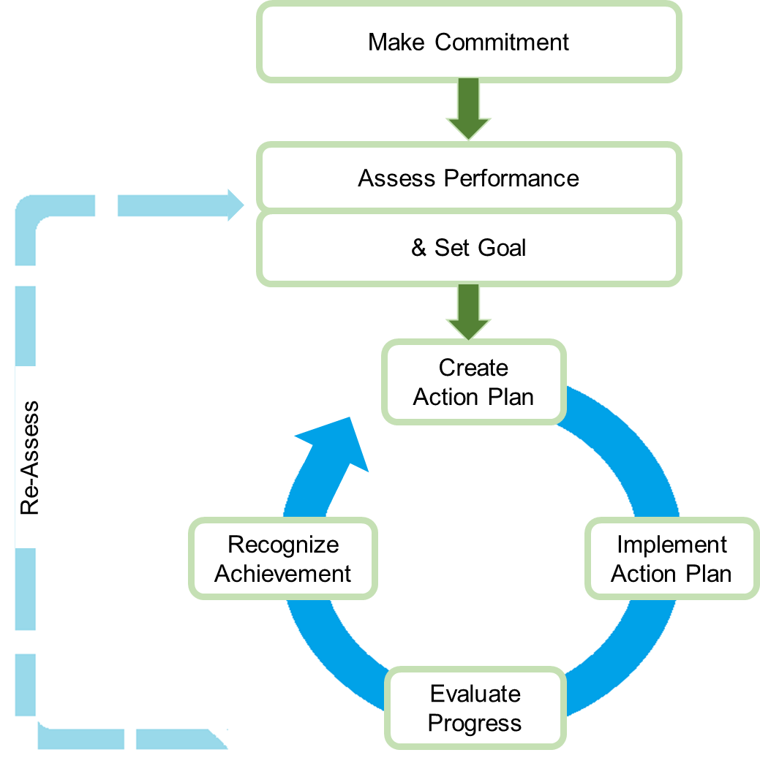
Highlights of Proposed GIZ Association
Proposed Broad Activities under IGEN Access II *
Sr. No. | Activity | Timeline^
1 | State level sensitization workshop | 0.5 Months
2 | Finalization of inter-departmental PMU | 1 Month
3 | Capacity building of PMU members on data collection/ analysis/ validation | 1-2 Months
4 | Data Collection & Analysis | 3-4 Months
5 | Creating/ validating baseline database & baseline energy scenario | 2 Months
6 | Development of State Energy Vision | 1-2 Months
7 | Development of Energy Scenarios to achieve state energy vision | 2 Months
8 | Developing Sectoral Energy Action Plan | 2-3 Months
9 | Writing/ Framing the Combined Action Plan | 2 Months
10 | EAP Website & Decision Support Tool Development | 2 Months
Steps in Energy-Action Planning
As-is Study
Stages of Deliverables
^ Timelines are tentative and may vary depending upon inter-departmental co-ordination & agreement on intermediate decision points
* Draft MoU (5. Scope of MoU)
“detailed list of activities will be separately agreed in writing depending upon the need envisaged at that point in time”
Prominent role for Department of Energy in partnering and anchoring State-level formation of long-term energy plan
Formation of required governance mechanism as recommended in Energy Policy (Draft) 2018, for implementing various plans

Slide 14
Stages of Collaboration
1
2
3
Preparation of State Energy Balance Sheet
Familiarization of Data Collection Model
Departmental interaction for collection of required datasets
Activating feedback mechanism on need basis
Preparation of Energy Balance Sheet
Assessing Sectoral Energy Requirement
Framing energy requirement scenarios for participating departments
Creation of models for business as usual vis-à-vis aspirational levels
Opening-up inter-departmental dialogues inline with State energy vision
Preparation of Energy Action Plan & Decision Support Tool
Formation on energy usage related ideas as applicable for State of Jharkhand
Penning down action plan inline with State Vision
Unveiling customized decision support tool to train scenarios
Broad Objectives of IGEN Access II
The program is an independent assessment by the State for understanding energy-sustainable potential of itself
While the working models are broadly inline with national aspirations (increasing renewable share, E-mobility etc.), the decision-support model works on scenarios as applicable to that particular State, keeping in mind macro-economic guidelines as applicable
Energy Action Plan (EAP) is a planning process which creates a cohesion amongst participating departments, cutting-across their individual energy usage aspirations and plugging it to State’s economic propositions for a decade-long period

Slide 15
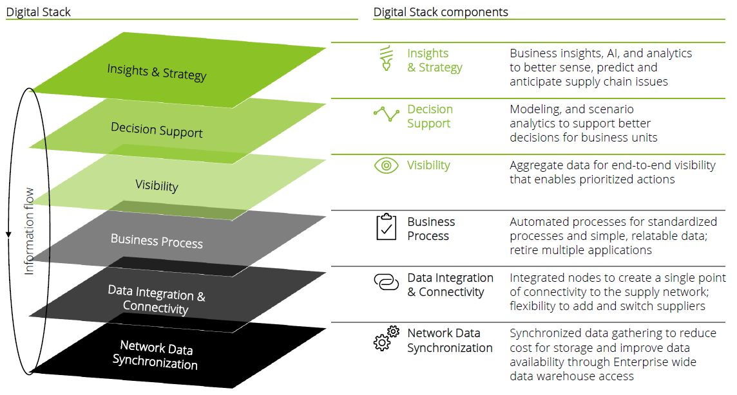
Stage 1: Preparation of State Energy Balance Sheet
Activities: Stage 1
Brief Description
a. Data Collection Framework
 | Data Collection Framework | Identification of participating departments by State Secretariat Preparation of customized Data Collection frameworks
 | Data Collection | Kicking-off program with initial data collection activities by the on-ground team Engaging in required stakeholder discussions
 | Sectoral Data Sheets | Preparation of sectoral data-sheets based on collected data-sets Data validation with respective departments
 | State Energy Balance Sheet | Data calibration for preparing input sets Formulation of State Energy Balance Sheet
b. Data Collection
Key inputs/ data/ Support from participating Departments
c. Sectoral Data Sheets
d. State Energy Balance Sheet
Highlights of Stage 1
The on-ground timeline assessed for Stage 1 activities is around 7 months (includes PMU Capacity Building & creating/ validating baseline database and baseline energy scenarios)
Broad objective/ goal of Stage-1 activities are creating a clear picture about State-level energy aspirations & preparation of baseline for next levels of analysis
The major outcome is framing Energy Balance Sheet, a scientific and methodical input model for creating scenarios
Annexure: Sample Energy Balance Sheet

Slide 16
Stage 2: Assessing Sectoral Energy Requirement
Activities: Stage 2
Brief Description
a. Reference Energy System
 | Reference Energy System | Identification of benchmark w.r.t. prepared State energy balance sheet Preparing/ finalizing Energy Demand scenario
 | Model Input Sheets | Sensitization of raw data using modelling s/w Preparation of data as required for sectoral energy scenario analysis
 | Model BAU Scenario | Data modelling for running Business As Usual (BAU) scenarios for various sectors Testing/ modifying input data as required
 | Potential Sectoral Intervention | Formation of sectoral action plans based on model-based analysis/ calculation Laying foundation for framing state-level long-term strategy
b. Model Input Sheets
Data Analysis & Scenario Building for Modular/ Short-term Action Plans
c. Model BAU Scenario
d. Potential Sectoral Intervention
Highlights of Stage 2
The on-ground timeline assessed for Stage 2 activities is around 9 months (includes development of Draft State Energy Vision & Data-driven Sectoral Energy Action Plans)
Broad objectives under Stage-2 are creating important building blocks in effecting data collection activities and reaching final objective of preparing EAP
The major outcome from Stage-2 is finalization of broad modules of sectoral action plans
Annexure: Sample Energy System Modelling Framework

Slide 17
Stage 3: Preparation of EAP & Decision Support Tool
Activities: Stage 3
Brief Description
a. Potential State Energy Scenarios
 | Potential State Energy Scenarios | Framing sector-driven energy scenarios for Jharkhand, keeping inline with the overall macro-economic prospects
 | Finalizing State Energy Vision | Delivering energy Vision statement for Jharkhand, capturing specific aspirations and prospects
 | Identification of Sectoral Activities | In this step, specific activities for participating sectors are framed, which are inline to derived state vision
 | Preparing EAP & Decision Support Tool | The Energy Action Plan is delivered A Decision Support Tool is commissioned to help Jharkhand with future analysis
b. Finalizing State Energy Vision
Assistance to State in framing action pointers & extending further support
c. Identification of Sector-level activities
d. Preparing EAP & Decision Support Tool
Highlights of Stage 3
The on-ground timeline assessed for Stage 3 activities is around 4 months (includes guidelines for sectors/ segments and providing Scenario-analysis tool for decision support)
Broad objectives under Stage-3 are delivering a robust macro-economic picture for Jharkhand, where energy utilization and sourcing can be optimized
Outcome from this stage are stated project deliverables and opening-up channels for future assistance, as mutually agreed
State Energy Vision, along with state-level objective, also captures sectoral planning for meeting specific goals
Decision Support Tool can help do various multi-sector sensitivity analysis in assessing impact of energy-centric decisions

Slide 18
Impact Delivered: Assam & West Bengal (Ongoing)
Along with development of Energy Action Plan, the States are in the process of signing MoUs for implementation of derived action-points from the IGEN Access study
GIZ shall be providing technical assistance to the States in developing respective strategies
Assam
West Bengal
Development of 100% Renewable Energy Scenario, in which Assam shall become the first State having such a policy push
Revival of Assam Solar Policy
Capability building for core group of state government employees in adopting EAP
Possible future areas of co-operation:
Assam Biomass Mission
Integrating DRE with Livelihood
Capability building of group of employees across departments responsible for handling EAP portal
Implementing Solar Rooftop PV Program
Supporting E-mobility (Policy & regulation w.r.t. charging infrastructure integration with grid)
Developing market eco-system to implement Solar Water Pumps (training & capacity-building of FIs)

Slide 19
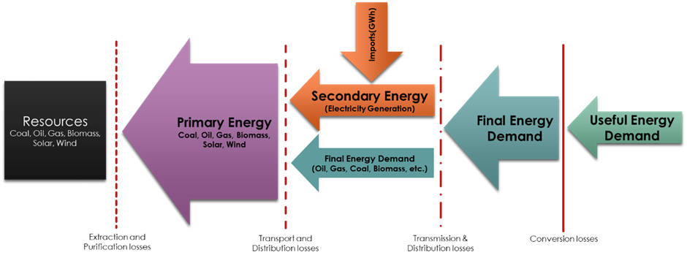
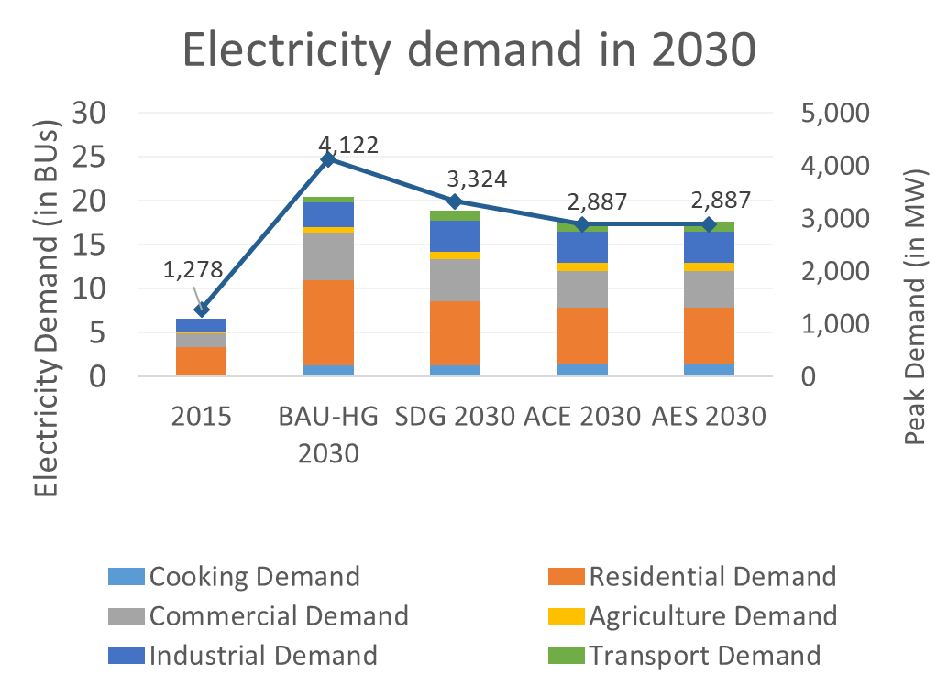
Annexure: Illustrations/ Sample Figures
Energy Balance Calculation: West Bengal
Approach to Energy System Modelling: West Bengal
Sectoral Electricity Demand: Assam
Stage-1: Energy Balance Sheet
Stage-2: Sectoral Energy Requirement

Slide 20
Thank You

Slide 21
Indo-German Energy (IGEN) Access II Program
Discussion on Possible Areas of Engagement
Department of Energy
Government of Jharkhand

Slide 22
GIZ: Background
Deutsche Gesellschaft für Internationale Zusammenarbeit (GIZ) GmbH on behalf of the German Federal Ministry for Economic Cooperation and Development (BMZ) and the Indian Ministry of New and Renewable Energy (MNRE) is promoting Indo-German Energy Programme (IGEN Access -II) in India
The program is already being executed in West Bengal and Assam with few other states in the process of being on-boarded
A presentation in this regard was conducted in Jharkhand with Hon'ble Additional Chief Secretary (Energy)
Worldwide Presence
Projects in India
Operations in Germany & over 120 Countries
Over 1,500 Ongoing Projects
Business Volume exceeded EUR 2.6 Billion
80% of the business volume was commissioned through BMZ
Business volume through GIZ international services: EUR 149 million
GIZ’s work was commissioned by more than 200 public & private sector bodies
Access to Energy in Rural Areas-II (IGEN Access II)
Promotion of Solar Water Pumps
Indo-German Solar Energy Partnership (IGSP)
Indo-German Energy Forum (IGEF)
Indo-German Energy Programme (IGEN)
Energy Efficiency (IGEN – EE)
Integration of Renewable Energies into the Indian Electricity System (I-RE)
IGEN-GEC-Rooftop Solar PV Component

Slide 23
Program Objective: IGEN Access II
From perspective of Dept. of Energy, access to affordable & reliable energy along-with optimizing fuel sources (Power Purchase) are the two major growth drivers
The State has been able to meet between 4.7% to 13% of RPO targets in past three published FYs, showing highly skewed energy-mix
Measures have been undertaken (tying-up 700MW Solar & 250MW Wind Power along with push to PM-KUSUM, Solar Rooftop programs)
Guidance envisaged in terms of implementation push
Indo-German Energy (IGEN) Access II, as part of ongoing collaboration between respective nations, is a program with underlined objective of improving energy supply in rural areas
The broad values envisaged for Dept. of Energy can be categorized as below -
Access to international expertise which addresses time & resource crunch of the Dept. in making plans for future
No additional financial burden on State exchequer as the program is part of ongoing national level association
Energy scenario planning for next 10-15 years through EAP tool, employee up-skilling, opportunity to align on further state-level visions

Slide 24
Expected Outcome
Clearer understanding of challenges/ barriers in attaining goal of providing clean & reliable energy access
State-level Energy Action Plan for a period of 10-15 years (inline with SDG 2030 timeline)
Decision Support Tool hosted at state-level and operated by core-group of employees to evaluate and analyze scenarios on State’s aspirations from energy perspective
The program, effectively planned, has the ability to push both ranking and score of Jharkhand on Sustainable Development Goals (SDG) Index and ensure targeted economic development. Few impact areas may be as below -
Socio-economic Impact Areas
Ensuring Energy Access to last-mile Consumers shall contribute to improving parameters such as Poverty Elimination & improving healthcare
Progress under education, gender equality & reduction in social inequalities can be ensured by affordable modes of electricity access
In future of innovation or planning smart-cities, a robust Renewable Energy Plan shall play a key role, thus contributing in improving related parameters
Energy access to MSMEs inline with national growth plan shall help job creation whereas sanitation is ensured by social growth

Slide 25
Highlights of Proposed GIZ Association
Proposed Broad Activities under IGEN Access II *
Sr. No. | Activity | Timeline^
1 | State level sensitization workshop | 0.5 Months
2 | Finalization of inter-departmental PMU | 1 Month
3 | Capacity building of PMU members on data collection/ analysis/ validation | 1-2 Months
4 | Data Collection & Analysis | 3-4 Months
5 | Creating/ validating baseline database & baseline energy scenario | 2 Months
6 | Development of State Energy Vision | 1-2 Months
7 | Development of Energy Scenarios to achieve state energy vision | 2 Months
8 | Developing Sectoral Energy Action Plan | 2-3 Months
9 | Writing/ Framing the Combined Action Plan | 2 Months
10 | EAP Website & Decision Support Tool Development | 2 Months
Suggested Governance Structure
Committee | Team Composition | Review Frequency
Steering Committee (Policy level Inputs) | Chief Secretary ACS-Energy Programme Head (GIZ) | Quarterly
Working Committee (Strategic Inputs) | ACS-Energy Joint Secretaries Project Manager of GIZ | Monthly
Project Implementation Members (Operational Inputs) | Technical Experts engaged by Dept. of Power Consultants engaged by GIZ | Weekly
As-is Study
Stages of Deliverables
^ Timelines are tentative and may vary depending upon inter-departmental co-ordination & agreement on intermediate decision points
* Draft MoU (5. Scope of MoU)
“detailed list of activities will be separately agreed in writing depending upon the need envisaged at that point in time”

Slide 26
Impact Delivered: Assam & West Bengal (Ongoing)
Along with development of Energy Action Plan, the States are in the process of signing MoUs for implementation of derived action-points from the IGEN Access study
GIZ shall be providing technical assistance to the States in developing respective strategies
Assam
West Bengal
Development of 100% Renewable Energy Scenario, in which Assam shall become the first State having such a policy push
Revival of Assam Solar Policy
Capability building for core group of state government employees in adopting EAP
Possible future areas of co-operation:
Assam Biomass Mission
Integrating DRE with Livelihood
Capability building of group of employees across departments responsible for handling EAP portal
Implementing Solar Rooftop PV Program
Supporting E-mobility (Policy & regulation w.r.t. charging infrastructure integration with grid)
Developing market eco-system to implement Solar Water Pumps (training & capacity-building of FIs)

